Slide 1

Computer Communications
& Networks
CSNC-2413
Week: 10
Computer Networking:
A Top Down Approach
6th edition
Jim Kurose, Keith Ross
Addison-Wesley
March 2012
Ch 3 : TCP
Dr Nauman Mazhar
Faculty of Information Technology (FIT)
University of Central Punjab (UCP)

Slide 2
Chapter 3 outline
3.1 Transport-layer services
3.2 Multiplexing and
demultiplexing
3.3 Connectionless
transport: UDP
3.4 Principles of reliable data
transfer
3.5 Connection-oriented
transport: TCP
  segment structure
  reliable data transfer
  flow control
  connection management
3.6 Principles of congestion
control
3.7 TCP congestion control

Slide 3
TCP: Overview (RFCs: 793, 1122, 1323, 2018, 2581)
connection-oriented:
  handshaking
  (exchange of control msgs)
  init’s sender/receiver state before data exchange
  (e.g, seq nums, buffer size)
Pipelined protocol:
  for efficiency
point-to-point:
  one sender, one receiver
  (not multicast)
full duplex data:
  bi-directional data flow on same connection
multiplexing / demultiplexing:
  based on 4-tuple values
reliable, in-order data delivery:
  error detection & control
  seq# for every byte
flow control:
  sender will not overwhelm receiver
  set receive window size
congestion control:
  sender will not overwhelm the network
  set congestion window size

Slide 4
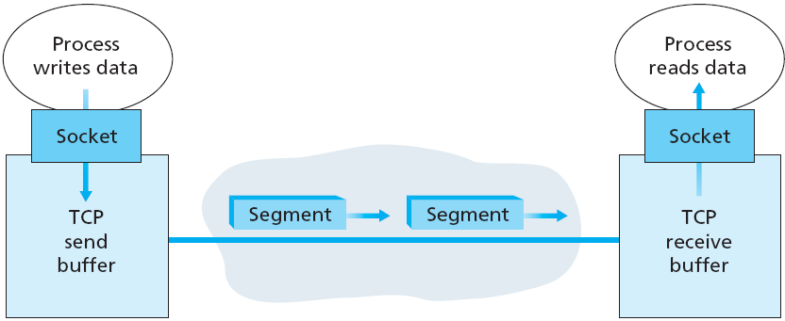
TCP: Overview
byte stream oriented protocol
  sending appl writes stream of data bytes into TCP socket
    into send buffer
  receiving appl reads stream of data bytes from TCP socket
    from receive buffer
  no “message boundaries”
  sending TCP forms segments
  (MSS: max segment size)
  sends to N/W layer for Tx
  receiving TCP receives TCP segments
  retrieves data, & reorders bytes

Slide 5
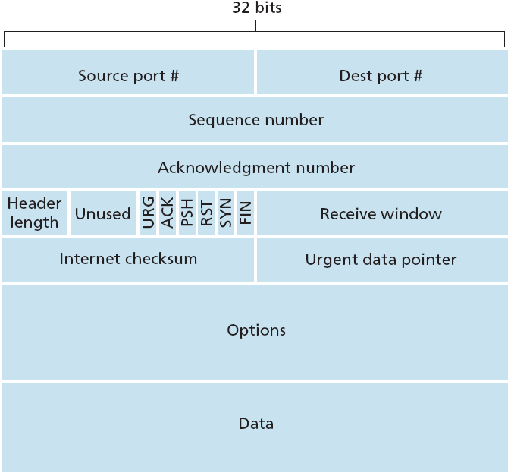
TCP segment structure
Header: fixed part
(20 bytes)
Header: variable size
(upto 60 bytes)

Slide 6
TCP segment structure
Source Port - 16 bit
  identify source application
Destination Port - 16 bit
  identify destination application
src/dest port numbers multiplex & demultiplex data from/to upper layer
Sequence Number - 32 bit
  sequence number of first data byte in segment
Acknowledgement Number - 32 bit
  sequence number of next data byte expected to be received
used by TCP sender and receiver
to implement reliable data transfer service
Notes:
Version (4 bits): Indicates version number, to allow evolution of the protocol; the value is 4.
Internet Header Length (IHL) (4 bits): Length of header in 32-bit words. The minimum value is five, for a minimum header length of 20 octets.
DS/ECN (8 bits): Prior to the introduction of differentiated services, this field was referred to as the Type of Service field and specified reliability, precedence, delay, and throughput parameters. This interpretation has now been superseded. The first six bits of this field are now referred to as the DS (differentiated services) field, discussed in Chapter 19. The remaining 2 bits are reserved for an ECN (explicit congestion notification) field, currently in the process of standardization. The ECN field provides for explicit signaling of congestion in a manner similar to that discussed for frame relay (Section 13.5).
Total Length (16 bits): Total datagram length, including header plus data, in octets.

Slide 7
TCP segment structure
Header Length - 4 bit
  length of header in 32 bit words
  variable length of 20 – 60 bytes
  typically 20 bytes (no options)
Flags - 6 bit
  determine the segment purpose
  SYN Flag: connection set up
  FIN Flag: connection tear down
  ACK Flag: value carried in acknowledgment field is valid
  PSH Flag: receiving TCP to immediately hand over data to appl
  URG Flag: sending appl has marked certain data in segment as urgent
  RST Flag: certain error conditions – close connection imm
Notes:
Version (4 bits): Indicates version number, to allow evolution of the protocol; the value is 4.
Internet Header Length (IHL) (4 bits): Length of header in 32-bit words. The minimum value is five, for a minimum header length of 20 octets.
DS/ECN (8 bits): Prior to the introduction of differentiated services, this field was referred to as the Type of Service field and specified reliability, precedence, delay, and throughput parameters. This interpretation has now been superseded. The first six bits of this field are now referred to as the DS (differentiated services) field, discussed in Chapter 19. The remaining 2 bits are reserved for an ECN (explicit congestion notification) field, currently in the process of standardization. The ECN field provides for explicit signaling of congestion in a manner similar to that discussed for frame relay (Section 13.5).
Total Length (16 bits): Total datagram length, including header plus data, in octets.

Slide 8
TCP segment structure
Receive Window - 16 bit
  used for flow control
  receiver advertises how many bytes
  willing to accept
Checksum - 16 bit
  verifies integrity of entire TCP segment
Urgent Pointer - 16 bit
  used with URG flag
  points to the location in segment where urgent data ends
  (add Urgent pointer value to Seq Num to determine
  location of urgent data)
  receiving TCP to inform appl, & pass pointer to urgent data

Slide 9
TCP segment structure
Options
  variable length TCP options;
  max 40 bytes
  MSS Option:
  sender and receiver negotiate MSS at
  connection setup
  (max TCP segment size minus header)
  Time-stamp Option:
  segment carries timestamp from sender, echoed by receiver;
  used to compute RTT samples, to estimate reTx timeout value
Padding
  TCP header must be aligned to 32 bit words (4 byte boundary)
  facilitates fragmentation at IP layer

Slide 10
TCP header fields in Wireshark

Slide 11
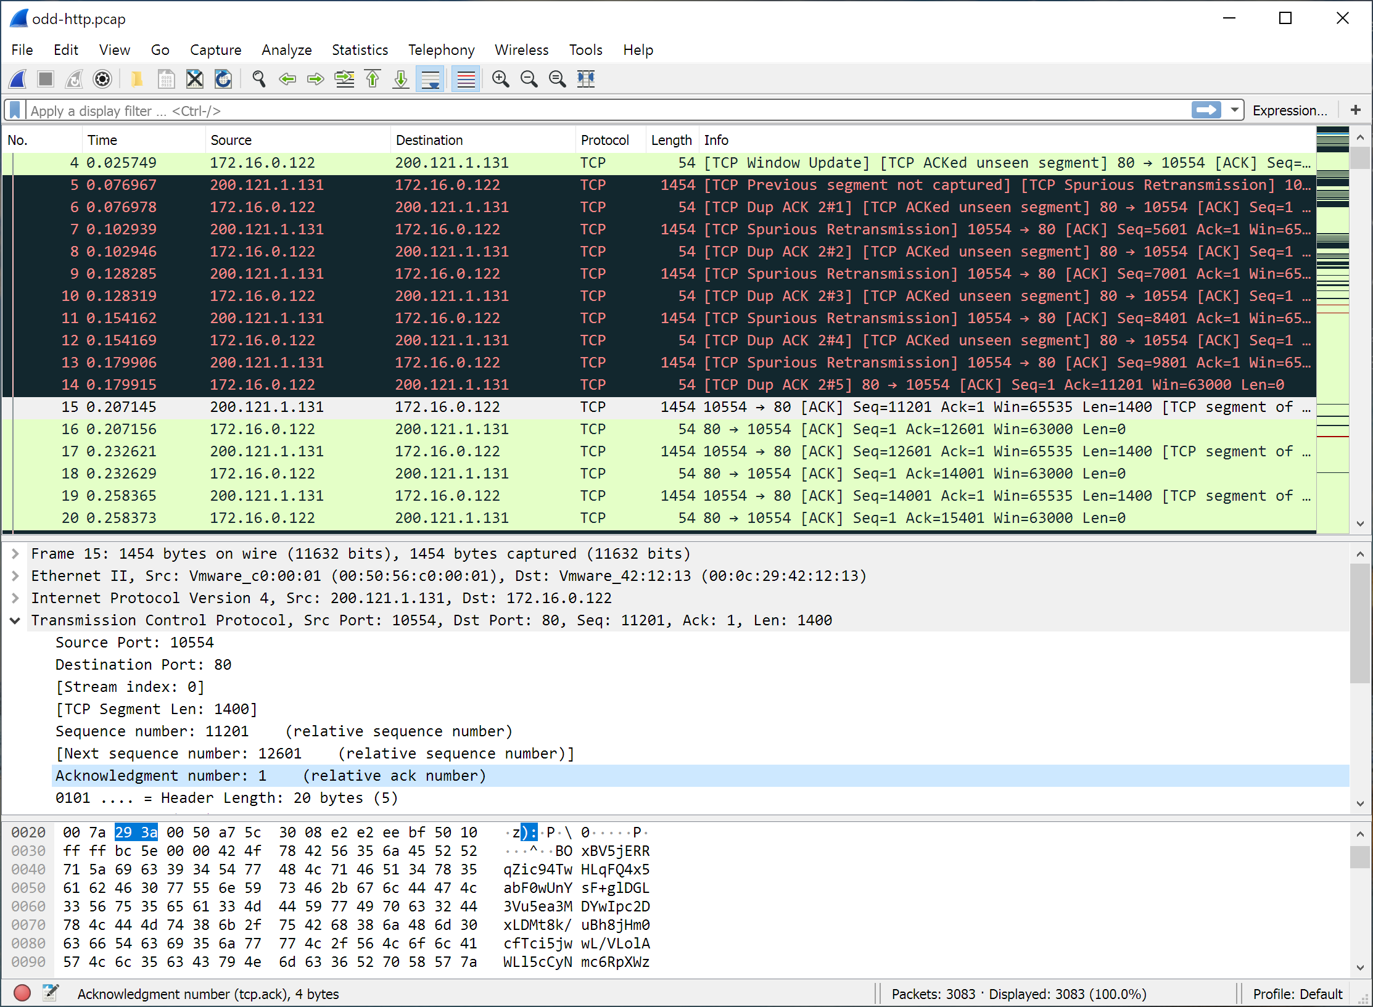

Slide 12
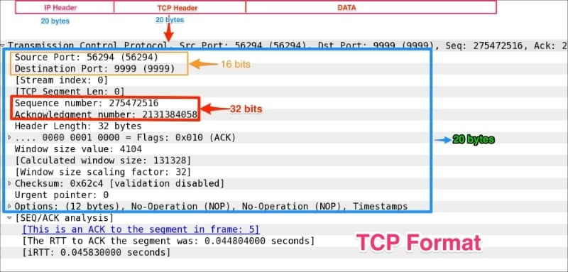
TCP header fields in Wireshark

Slide 13
Chapter 3 outline
3.1 Transport-layer services
3.2 Multiplexing and
demultiplexing
3.3 Connectionless
transport: UDP
3.4 Principles of reliable data
transfer
3.5 Connection-oriented
transport: TCP
  segment structure
  reliable data transfer
  flow control
  connection management
3.6 Principles of congestion
control
3.7 TCP congestion control

Slide 14
TCP Connection Management
Recall:
TCP sender, receiver establish “connection” before exchanging data segments
initialize TCP variables:
  seq#
  MSS
  flow control info
  (e.g. RcvWindow)
Three way handshake:
Step 1: client host sends TCP SYN segment to server
  specifies own ISN (initial seq#)
  no data
Step 2: server host receives SYN, replies with SYN-ACK segment
  specifies server ISN (initial seq#)
  no data
Step 3: client receives SYN-ACK, replies with ACK segment
  may contain data

Slide 15
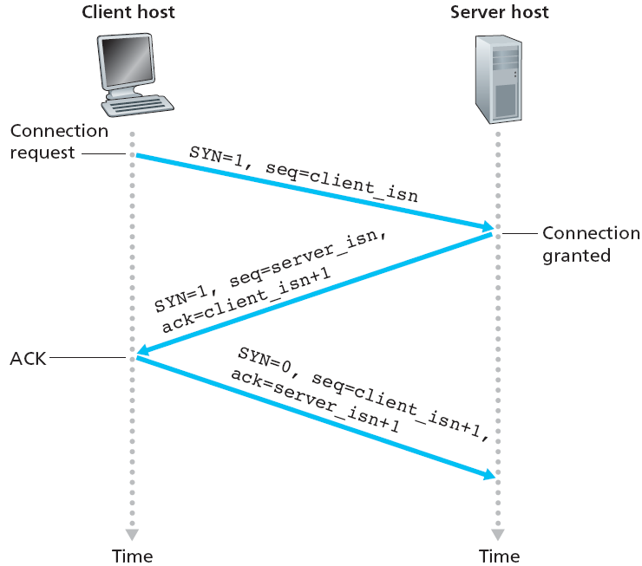
TCP three-way handshake

Slide 16
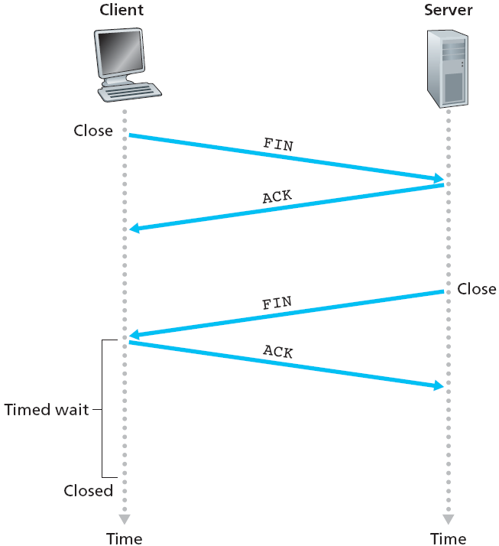
TCP Connection Management
Closing a connection:
Client closes socket
client TCP sends FIN segment to server
server TCP receives FIN, sends ACK
client TCP receives ACK, and closes client → server TCP connection
Server closes socket
server TCP sends FIN
client TCP receives FIN, sends ACK
server TCP receives ACK,
waits for some time,
and then closes TCP connection

Slide 17
Chapter 3 outline
3.1 Transport-layer services
3.2 Multiplexing and
demultiplexing
3.3 Connectionless
transport: UDP
3.4 Principles of reliable data
transfer
3.5 Connection-oriented
transport: TCP
  segment structure
  reliable data transfer
  flow control
  connection management
3.6 Principles of congestion
control
3.7 TCP congestion control

Slide 18
TCP Seq Numbers
Appl data viewed as unstructured, but ordered, byte stream
To keep track of bytes sent/received, TCP uses Seq Numbers
  Seq Num is NOT for transmitted segments
  “Seq Num in TCP header is byte-stream number of
  first byte in segment”
Example:
If a process in Host A wants to send 500 kB file to process in Host B, TCP sends the file as a byte-stream, & numbers each byte
If MSS is 1,000 bytes, TCP constructs 500 segments
  first segment has Seq Num 0
  second segment has Seq Num 1000
  third segment has Seq Num 2000, and so on

Slide 19
TCP Ack Numbers
Each segment sent from Host A to Host B, has Seq Num for data from A to B
Ack Num that Host B puts in Ack segment is,
Seq Num of next byte Host B is expecting from Host A
Example:
Suppose Host B has received bytes 0 thru 999 from Host A, and is waiting for byte 1000 onwards.
  Host B puts 1000 in Ack Num field of TCP segment it sends to Host A
TCP is full-duplex…
  While Host B receives data from Host A, it can also send data to Host A
  (as part of same TCP connection)
  Seq/Ack numbers maintained in both directions

Slide 20
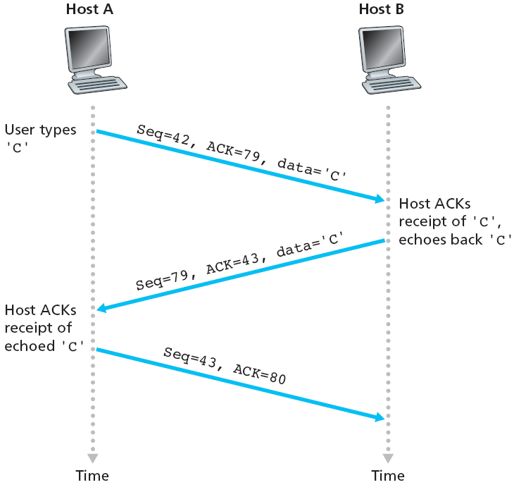
TCP Seq/Ack Numbers

Slide 21
TCP Seq/Ack Numbers
last incoming segment
source port #
dest port #
Ack Numbers:
  seq # of next byte expected from other side
  cumulative ACK
Seq Numbers:
  byte stream “number” of first byte in segment data
Q: how receiver handles out-of-order segments
  TCP spec does not say
  left upto implementor
sequence number
acknowledgement number
A
rwnd
checksum
urg pointer
window size
N
  sender sequence number space
sent
ACKed
sent, not-yet ACKed
usable
but not
yet sent
not
usable
source port #
dest port #
sequence number
acknowledgement number
rwnd
checksum
urg pointer
new outgoing segment

Slide 22
TCP Round Trip Time & Timeout
Q: how to set TCP timeout value?
longer than RTT
  but RTT varies
  so, estimate RTT
too long: slow reaction to segment loss, poor performance
too short: premature timeout
  unnecessary reTx
Q: how to estimate RTT?
SampleRTT: measured time from segment Tx till ACK receipt
  ignore reTx
SampleRTT will vary; want “smoother” estimated RTT
Estimated RTT is average of several recent measurements, not just current SampleRTT
tx
Estimated
RTT
tx
Estimated
RTT
Too short
retx
ack
Too long
ack
retx

Slide 23
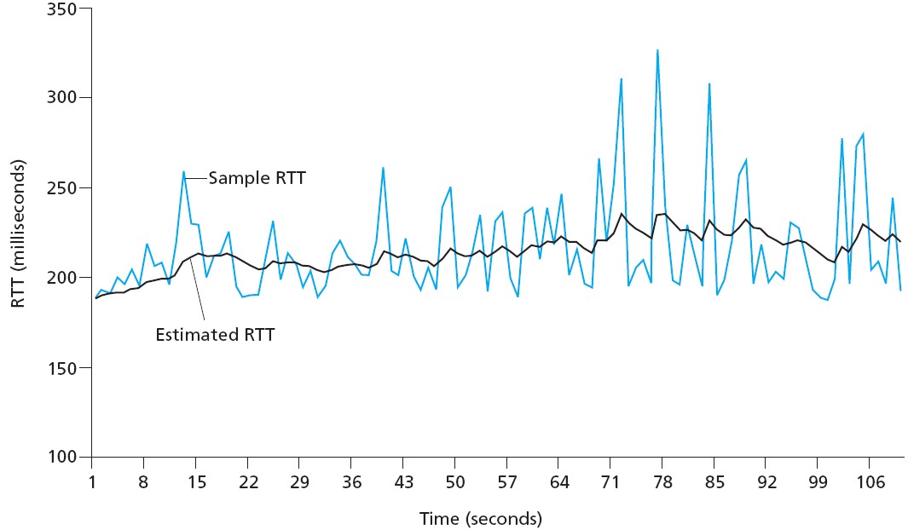
TCP Round Trip Time & Timeout
EstimatedRTT = (1- α)*EstimatedRTT + α*SampleRTT
exponentially weighted moving average (EWMA)
influence of past samples decreases exponentially fast
typical value: α = 0.125

Slide 24

TCP Round Trip Time & Timeout
Timeout interval:
  EstimatedRTT plus “safety margin”
  large variation from EstimatedRTT ⇒ larger safety margin
First estimate SampleRTT deviation from previous EstimatedRTT
DevRTT = (1-β)*DevRTT + β*|SampleRTT-EstimatedRTT|
(typically, β = 0.25)
Then compute new EstimatedRTT & Timeout as…
EstimatedRTT = (1- α)*EstimatedRTT + α*SampleRTT
TimeoutInterval = EstimatedRTT + 4*DevRTT
estimated RTT
“safety margin”

Slide 25
Practice Problem
Consider that Host A sends a TCP segment to Host B and measures the Sample RTT value as 106 ms. Assume that the value of Estimated RTT was 100 ms just before the sample was obtained, and the value of DevRTT was 5 ms. Using a value of α = 0.125 and β = 0.25, compute the TCP Timeout Interval after the RTT sample is obtained.
(First compute the DevRTT after the sample, then compute new Estimated RTT, and lastly the Timeout value)
DevRTT = (1-β)*DevRTT + β*|SampleRTT-EstimatedRTT|
EstimatedRTT = (1- α)*EstimatedRTT + α*SampleRTT
TimeoutInterval = EstimatedRTT + 4*DevRTT

